Slide 1
DATABASE MANAGEMENT SYSTEM
TEAM NO: 03
TEAM MEMBERS:
JAISON ARO. M
KAVYA SRI. R
KEERTHI VASAN. B
LOGESHWARAN. R
MADHAVAN. S. V
MEENALOSHINI. D

Slide 2
TABLE OF CONTENTS
TOPIC
ER-DIAGRAM
SQL CODE AND QUERIES
PHP CODE
HTML CODE
SUMMARY
OUTPUT SCREENSHOTS

Slide 3
TOPIC
Railway Information System
A railway system, which needs to model the following: 1. Stations 2. Tracks, connecting stations. You can assume for simplicity that only one track exists between any two stations. All the tracks put together to form a graph. 3. Trains, with an ID and a name 4. Train schedules recording what time a train passes through each station on its route. You can assume for simplicity that each train reaches its destination on the same day and that every train runs every day. Also for simplicity, assume that for each train, for each station on its route, you store Time in, Timeout (same as time in if it does not stop) A sequence number so the stations in the route of a train can be ordered by sequence number. 1. Passenger booking consisting of train, date, from-station, to station, coach, seat and passenger name.
Deliverables:
E-R Diagram of All entities, relationships and their data structure
SQL queries to book tickets, time table display, running status of trains

Slide 4
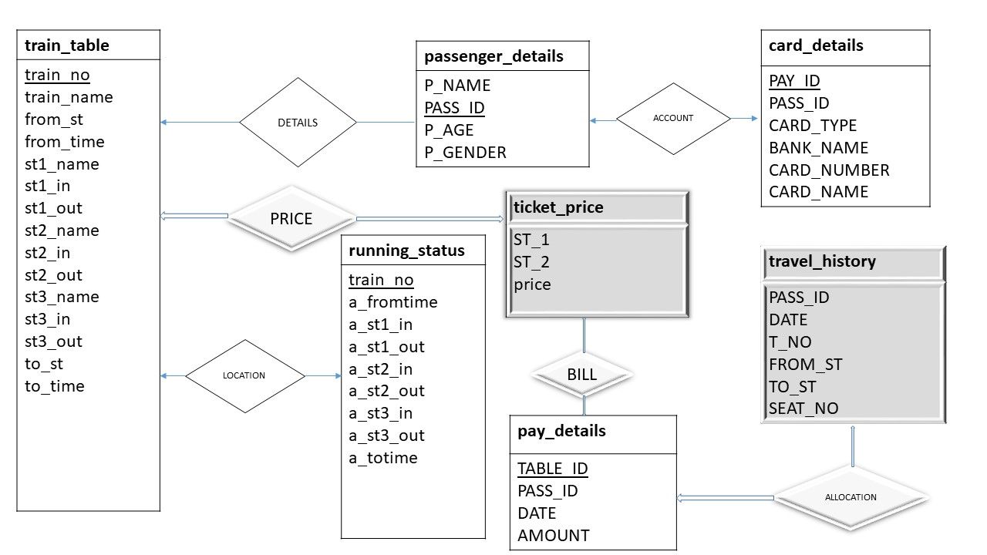
E-R DIAGRAM:

Slide 5
SQL CODE AND QUERIES
CREATE DATABASE railway_information;
USE railway_information;
TABLE 1:
CREATE TABLE train_table(
train_no int,
train_name varchar(20),
from_st varchar(20),
from_time time(0),
st1_name varchar(20),
st1_in time(0),

Slide 6
st1_out time(0),
st2_name varchar(20),
st2_in time(0),
st2_out time(0),
st3_name varchar(20),
st3_in time(0),
st3_out time(0),
to_st varchar(20),
to_time time(0),
PRIMARY KEY(train_no)
);
INSERT INTO train_table
VALUES ('12342’, 'TEJAS EXPRESS’, 'MADRAI’, '07:00’, 'DINDIGUL’, '08:00’, '08:05',’ KARUR’, '09:45’, '09:50’, 'ERODE’, ’11:00’, '11:10’, 'COIMBATORE’, '12:00');

Slide 7
TABLE 2:
CREATE TABLE passenger_details (
P_NAME VARCHAR(20) NOT NULL ,
PASS_ID INT NOT NULL PRIMARY KEY ,
P_AGE INT NOT NULL ,
P_GENDER VARCHAR(10) NOT NULL ,
);
TABLE 3:
CREATE TABLE ticket_price(
ST_1 VARCHAR(20) NOT NULL ,
ST_2 VARCHAR(20) NOT NULL ,
PRICE INT NOT NULL
);

Slide 8
INSERT INTO ticket_price (ST_1,ST_2,PRICE)
VALUES ('MADURAI', 'COIMBATORE', '250'),
('MADURAI', 'ERODE', '175'),
('MADURAI', 'KARUR','100'),
('MADURAI','DINDIGUL','75’),
('DINDIGUL','COIMBATORE','150’),
('DINDIGUL','ERODE','125’),
('DINDIGUL', 'KARUR','75’),
('KARUR','COIMBATORE','125’),
('KARUR','ERODE','100’),
('ERODE','COIMBATORE','75');

Slide 9
TABLE 4:
CREATE TABLE running_status(
train_no int primary key,
a_fromtime time,
a_st1_in time,
a_st1_out time,
a_st2_in time,
a_st2_out time,
a_st3_in time,
a_st3_out time,
a_totime time
);
INSERT INTO running_status(train_no,a_fromtime,a_st1_in,a_st1_out,a_st2_in,a_st2_out,a_st3_in,a_st3_out,a_totime)
VALUES ('12342','07:03','08:00','08:05','09:50','09:55','10:59','11.10','12:10');

Slide 10
TABLE 5:
CREATE TABLE travel_history(
PASS_ID INT,
DATE date,
T_NO INT,
FROM_ST VARCHAR(20),
TO_ST VARCHAR(20),
SEAT_NO INT DEFAULT 0
);
TABLE 6:
CREATE TABLE pay_details(
TABLE_ID INT PRIMARY KEY AUTO_INCREMENT,
PASS_ID INT,
DATE date,
AMOUNT INT
);

Slide 11
TABLE 7:
CREATE TABLE card_details(
PAY_ID INT PRIMARY KEY AUTO_INCREMENT,
PASS_ID INT,
CARD_TYPE VARCHAR(20),
BANK_NAME VARCHAR(20),
CARD_NUMBER INT,
CARD_NAME VARCHAR(20)
);
VIEW 1:
CREATE view final_list
as SELECT a.*,b.DATE,b.T_NO,b.FROM_ST,b.TO_ST, b.SEAT_NO
FROM passenger_details a, travel_history b
WHERE a.PASS_ID= b.PASS_ID and b.DATE ='2020-07-08';

Slide 12
VIEW 2:
CREATE view ticket
as SELECT a.*,b.DATE,b.T_NO,b.FROM_ST,b.TO_ST, b.SEAT_NO,c.AMOUNT
FROM passenger_details a
INNER JOIN travel_history b ON a.PASS_ID = b.PASS_ID
INNER JOIN pay_details c ON a.PASS_ID = c.PASS_ID AND b.DATE = c.DATE;
CANCELATION:
SET @cancel_id:= '';
SET @cancel_date:= '';
DELETE FROM travel_history WHERE PASS_ID = @cancel AND DATE = @cancel_date;
DELETE FROM pay_details WHERE PASS_ID = @cancel AND DATE = @cancel_date;
SET @c_train_no:='';
SET @c_train_date:=‘’;
DELETE FROM travel_history WHERE T_NO=@c_train_no AND DATE = @c_train_date;
DELETE FROM pay_details WHERE DATE = @c_train_date;

Slide 13
SET @t:= '08:00';
SELECT
if( @t<from_time, 'not started',
if(@t<st1_in, CONCAT('between ',from_st,'and ', st1_name),
if(@t<st1_out,CONCAT('in ', st1_name),
if(@t<st2_in,CONCAT('between', st1_name , 'and', st2_name),
if(@t<st2_out,CONCAT('in', st2_name),
if(@t<st3_in,CONCAT('between' , st2_name, 'and' , st3_name),
if(@t<st3_out,CONCAT('in' , st3_name),
if(@t<to_time,CONCAT('between' , st3_name , 'and' , to_st),
if(@t=to_time, CONCAT('in' , to_st), 'already reached')))))))))
FROM train_table;

Slide 14
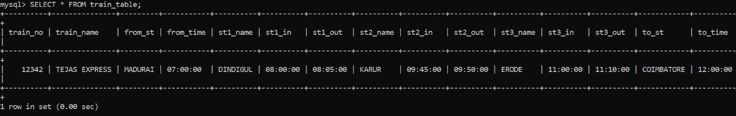
OUTPUT SCREENSHOTS:
train_table

Slide 15
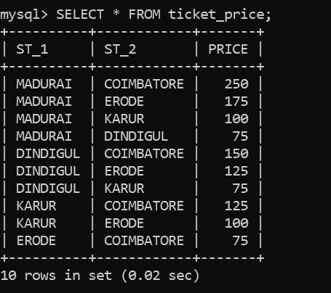
ticket_price

Slide 16
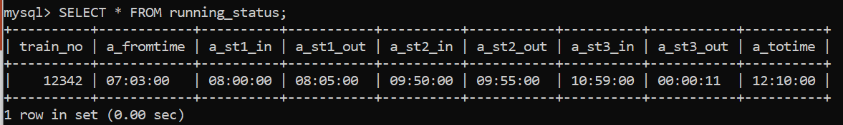
Running_status

Slide 17
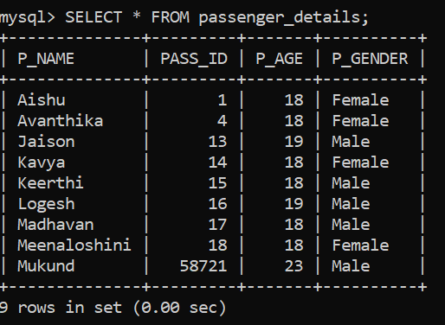
passenger_details

Slide 18
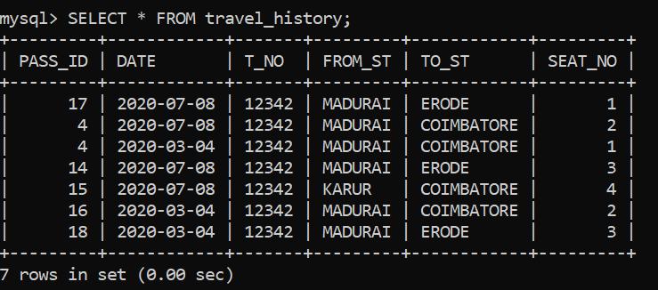
travel_history

Slide 19
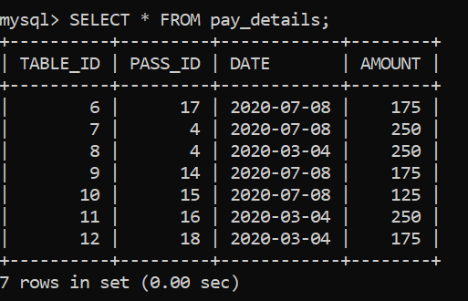
pay_details

Slide 20
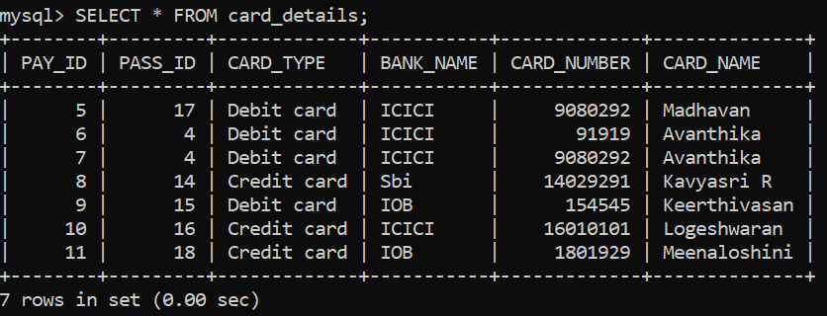
card_details

Slide 21
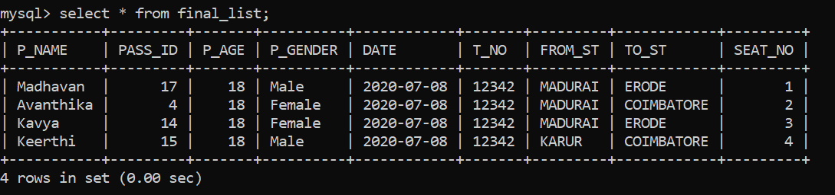
View 1- final

Slide 22
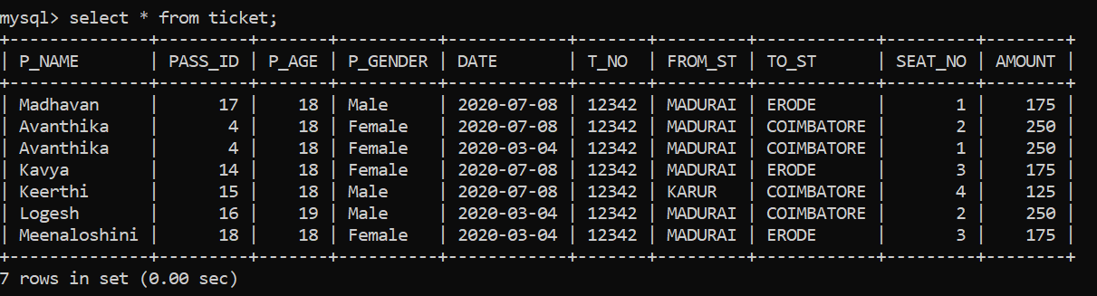
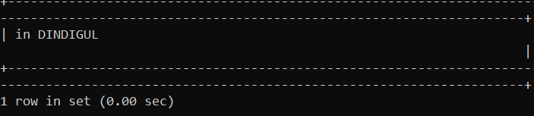
View 2
Running status

Slide 23
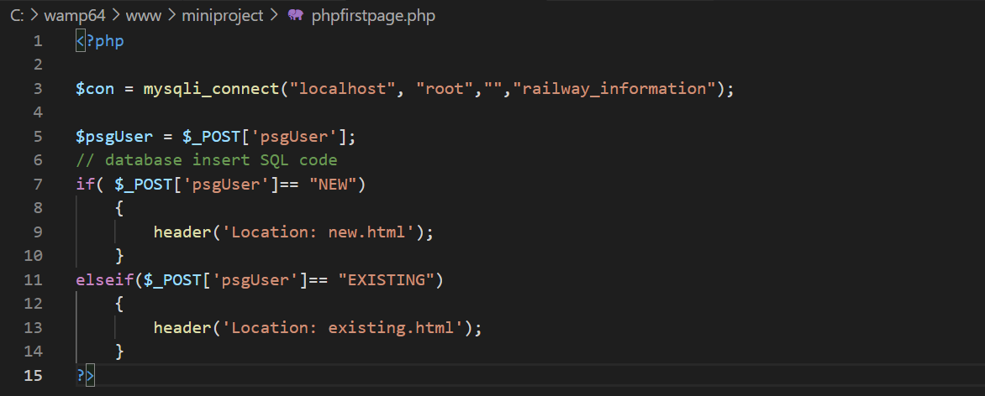
PHP CODE
Php for first page

Slide 24
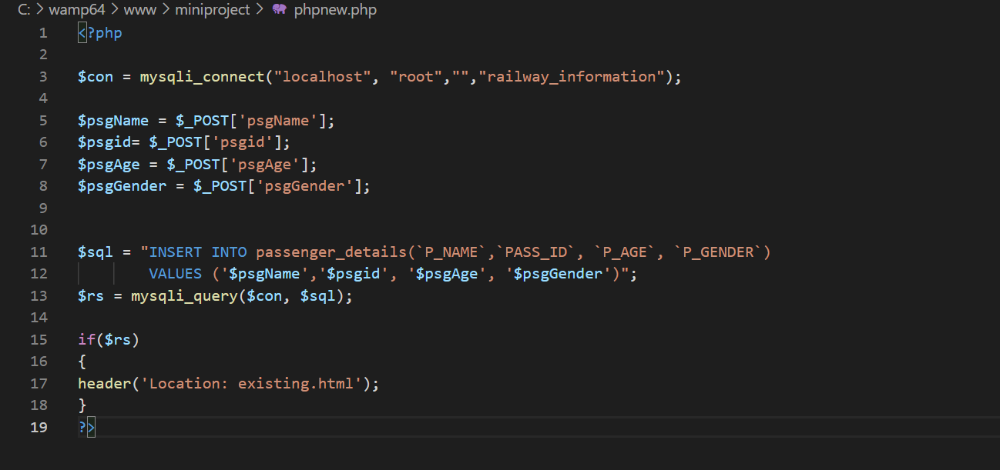
Php for new passenger details

Slide 25
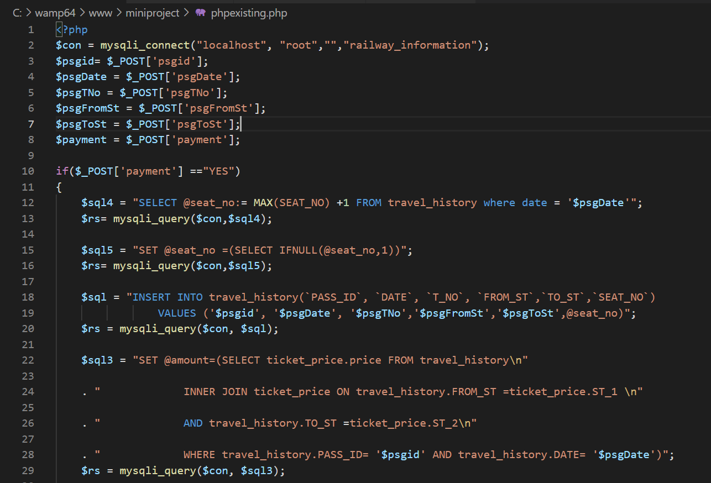
Php for existing user

Slide 26
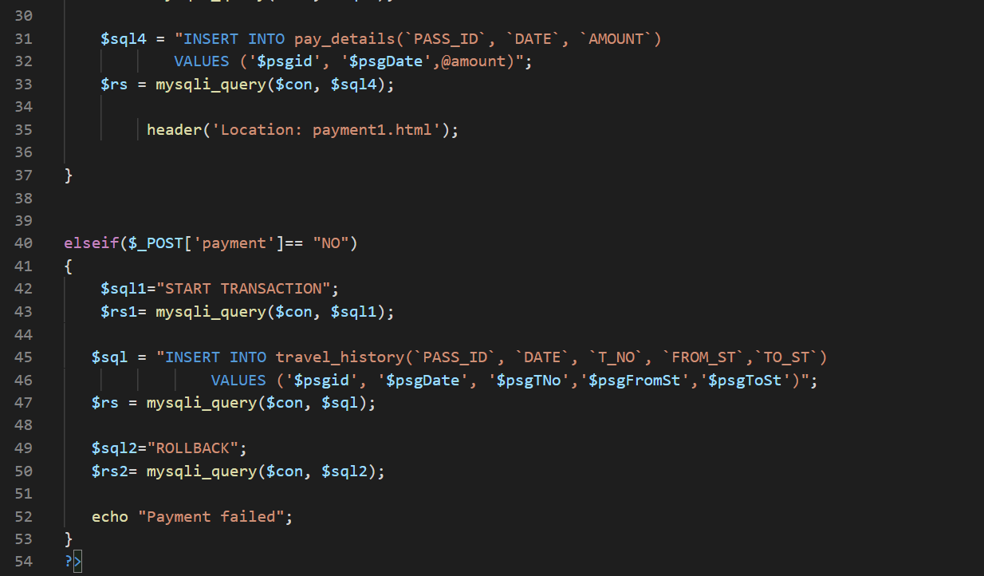

Slide 27
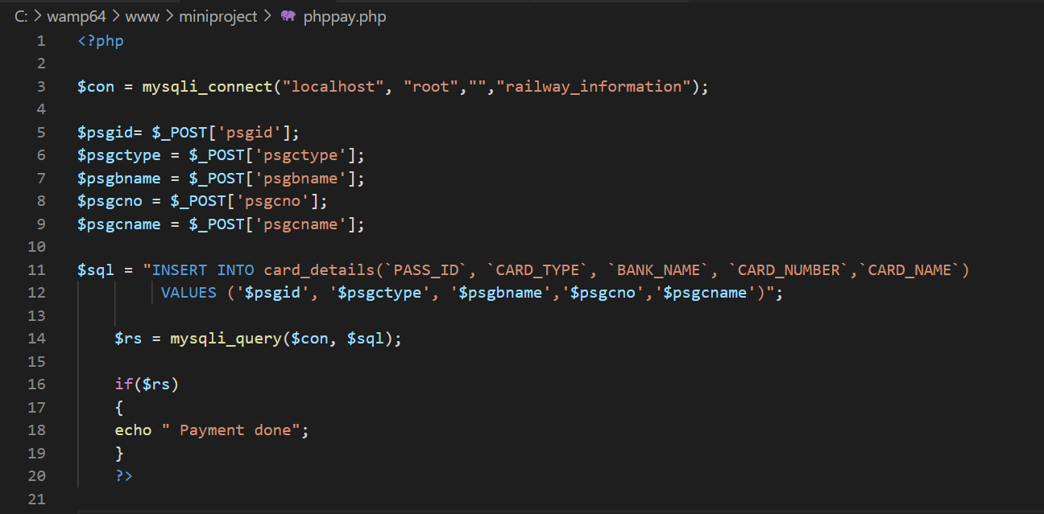
Php for payment method

Slide 28
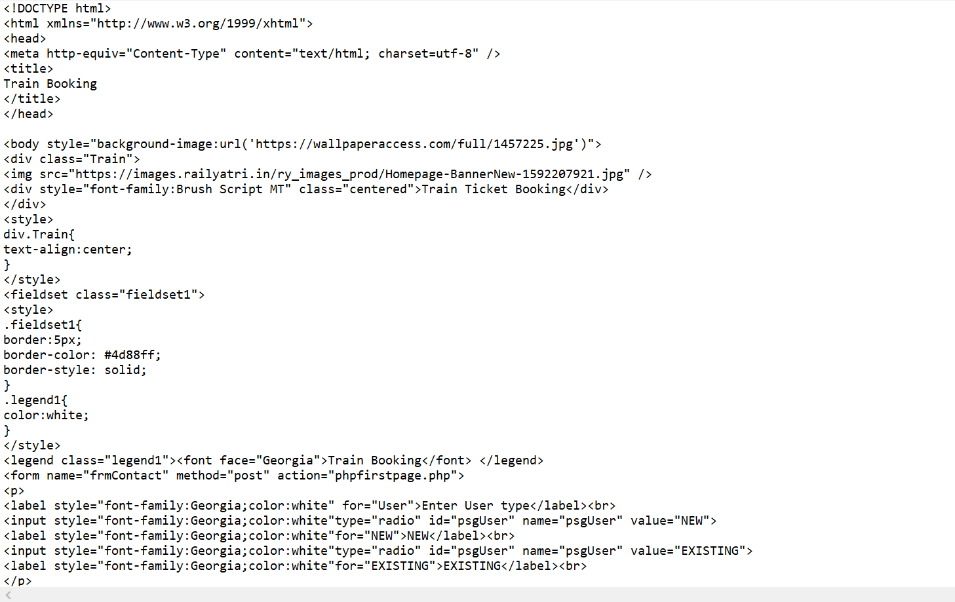
HTML CODE
First page

Slide 29
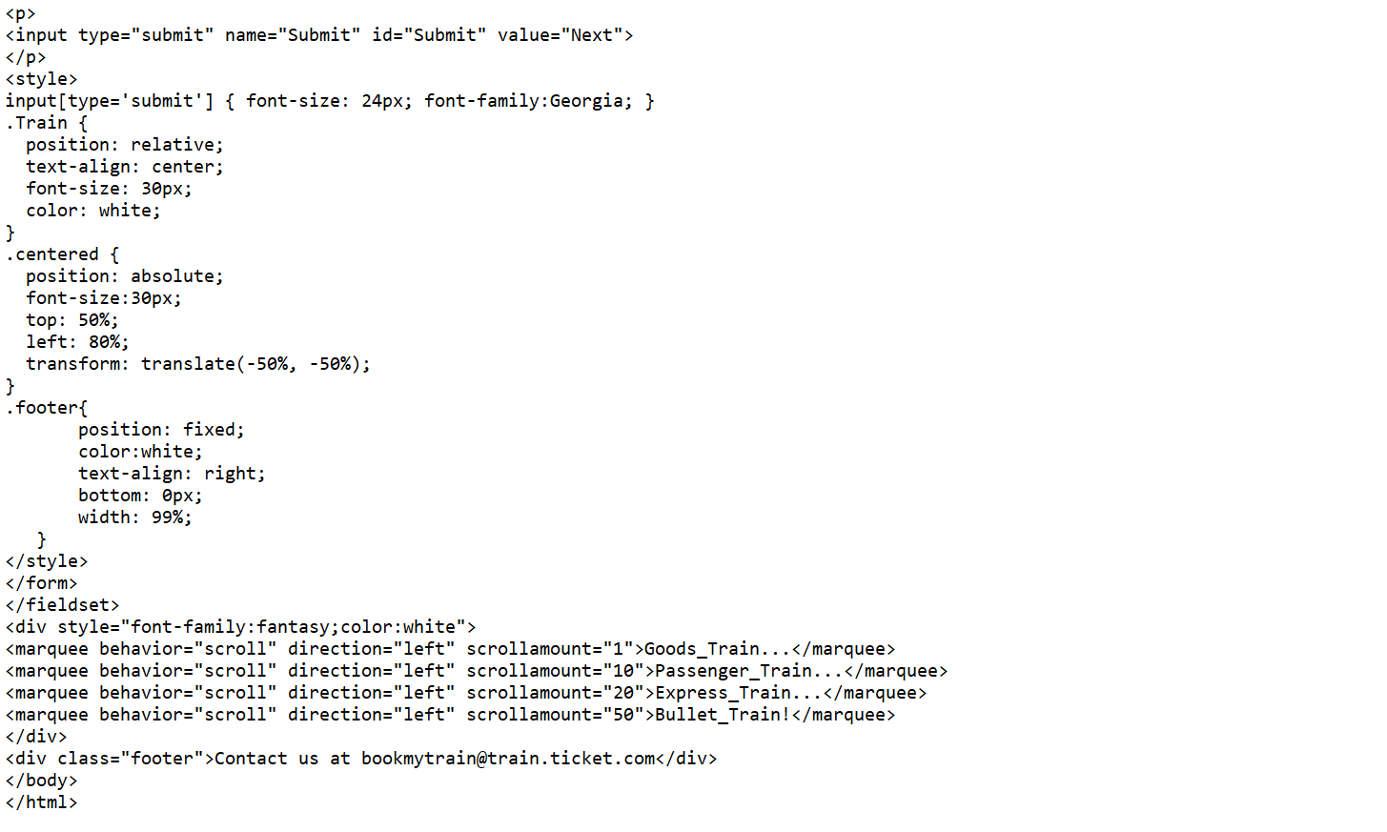

Slide 30
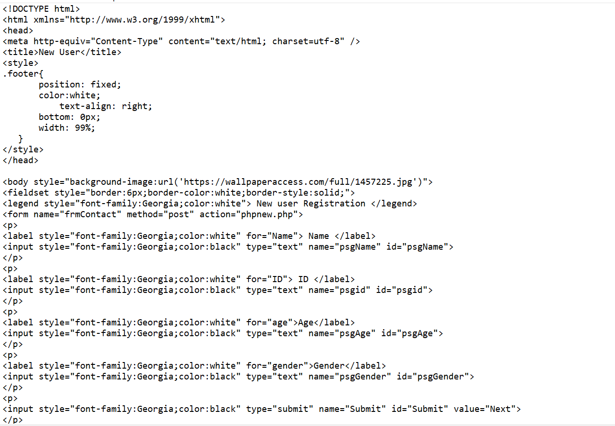
New user

Slide 31
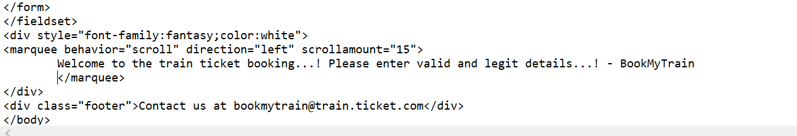
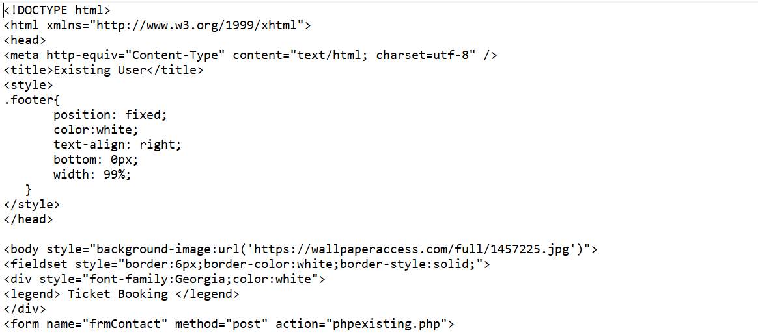
Existing user

Slide 32
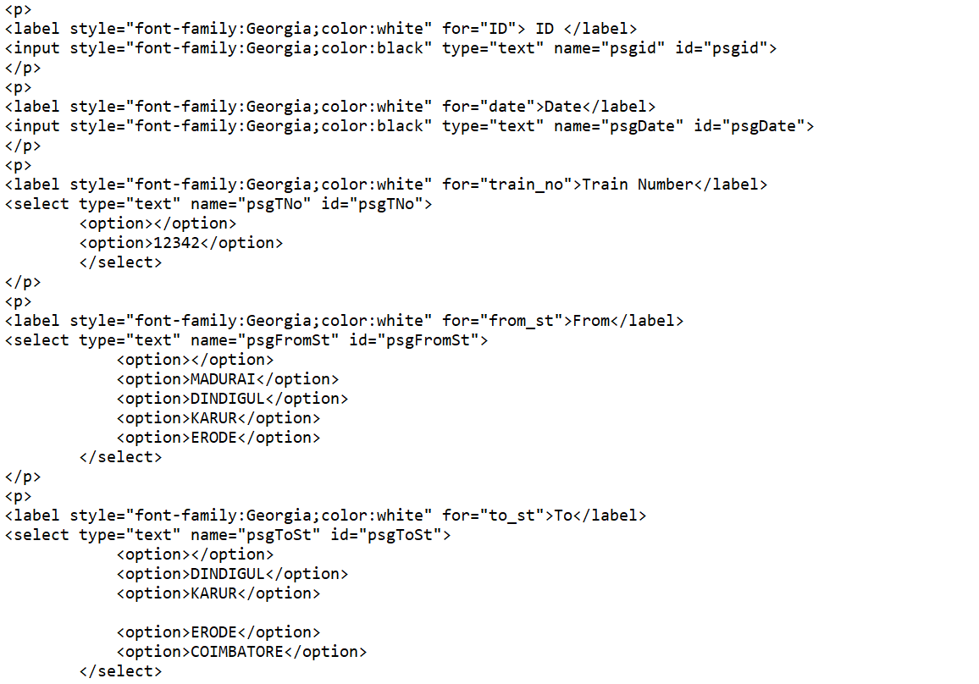

Slide 33
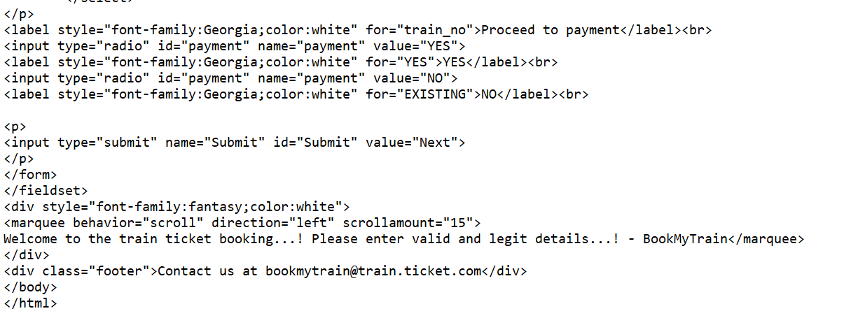

Slide 34
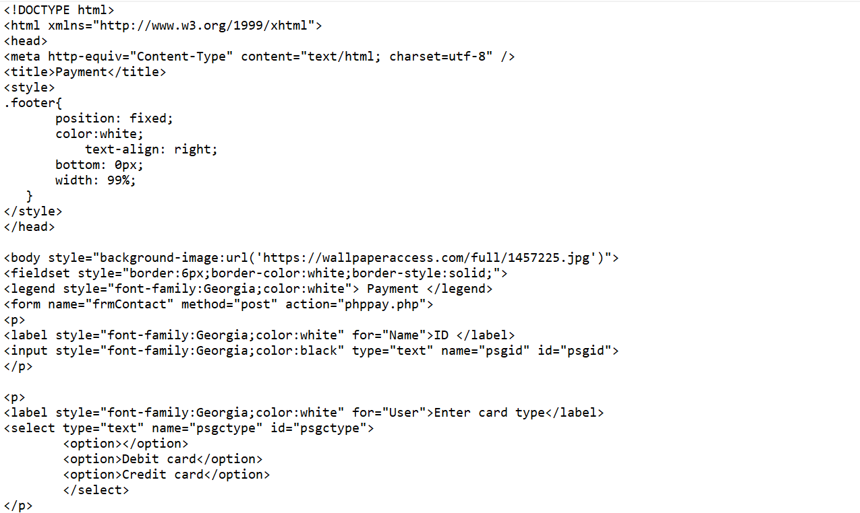
Payment

Slide 35
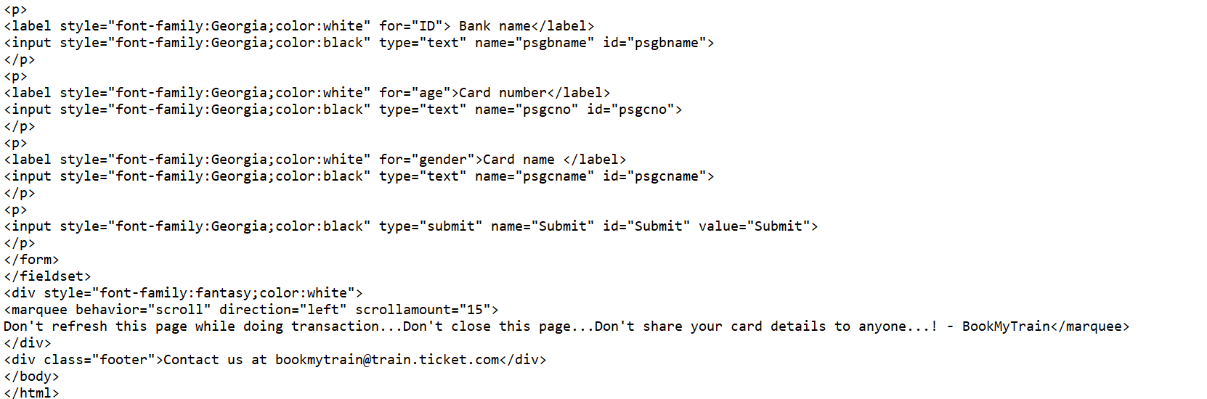

Slide 36
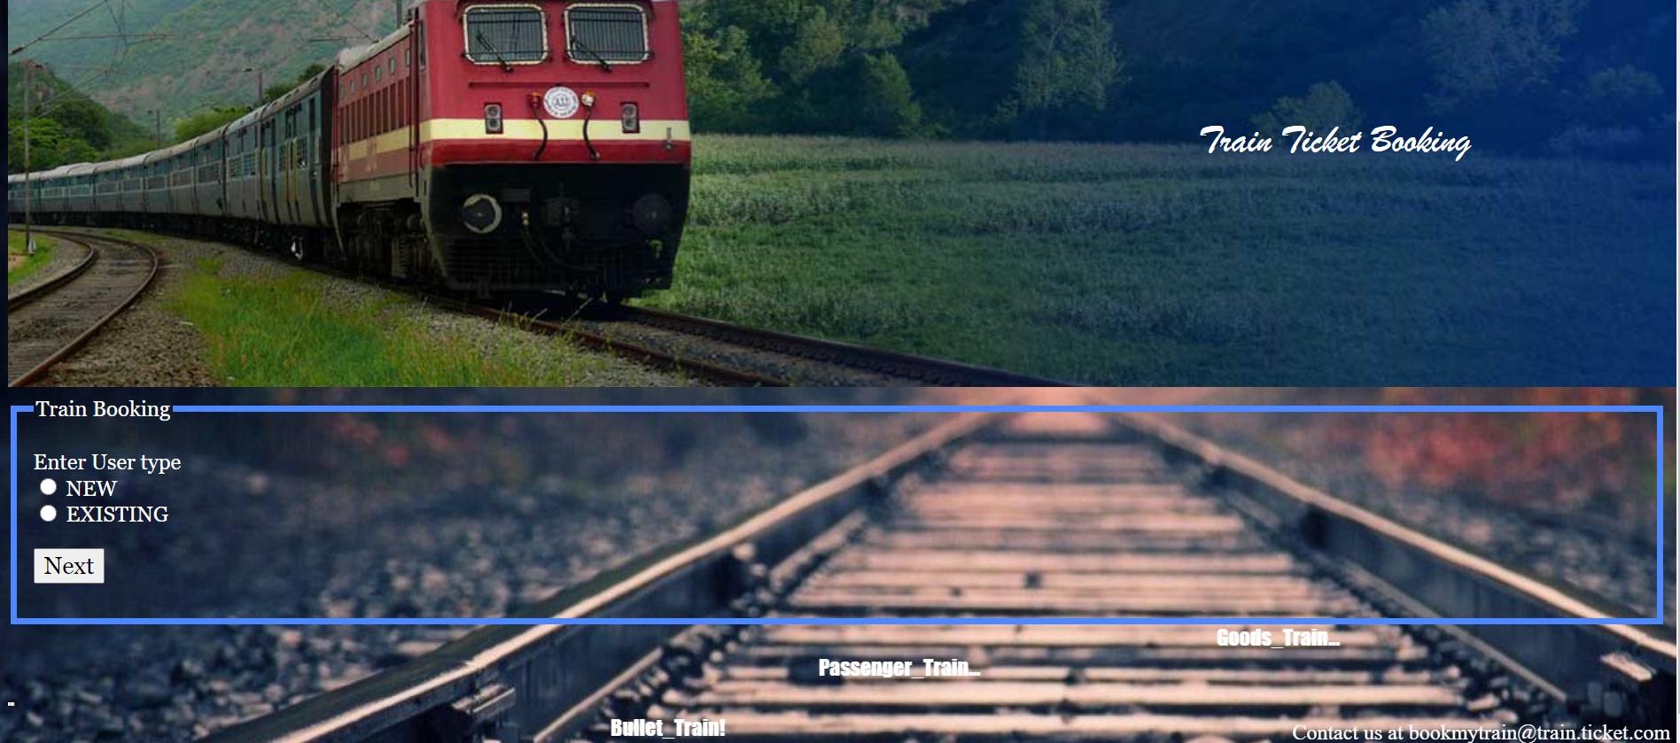
First page

Slide 37
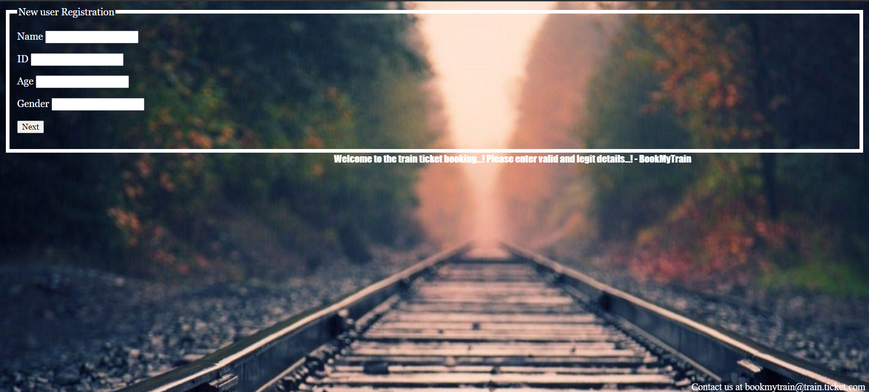
New

Slide 38
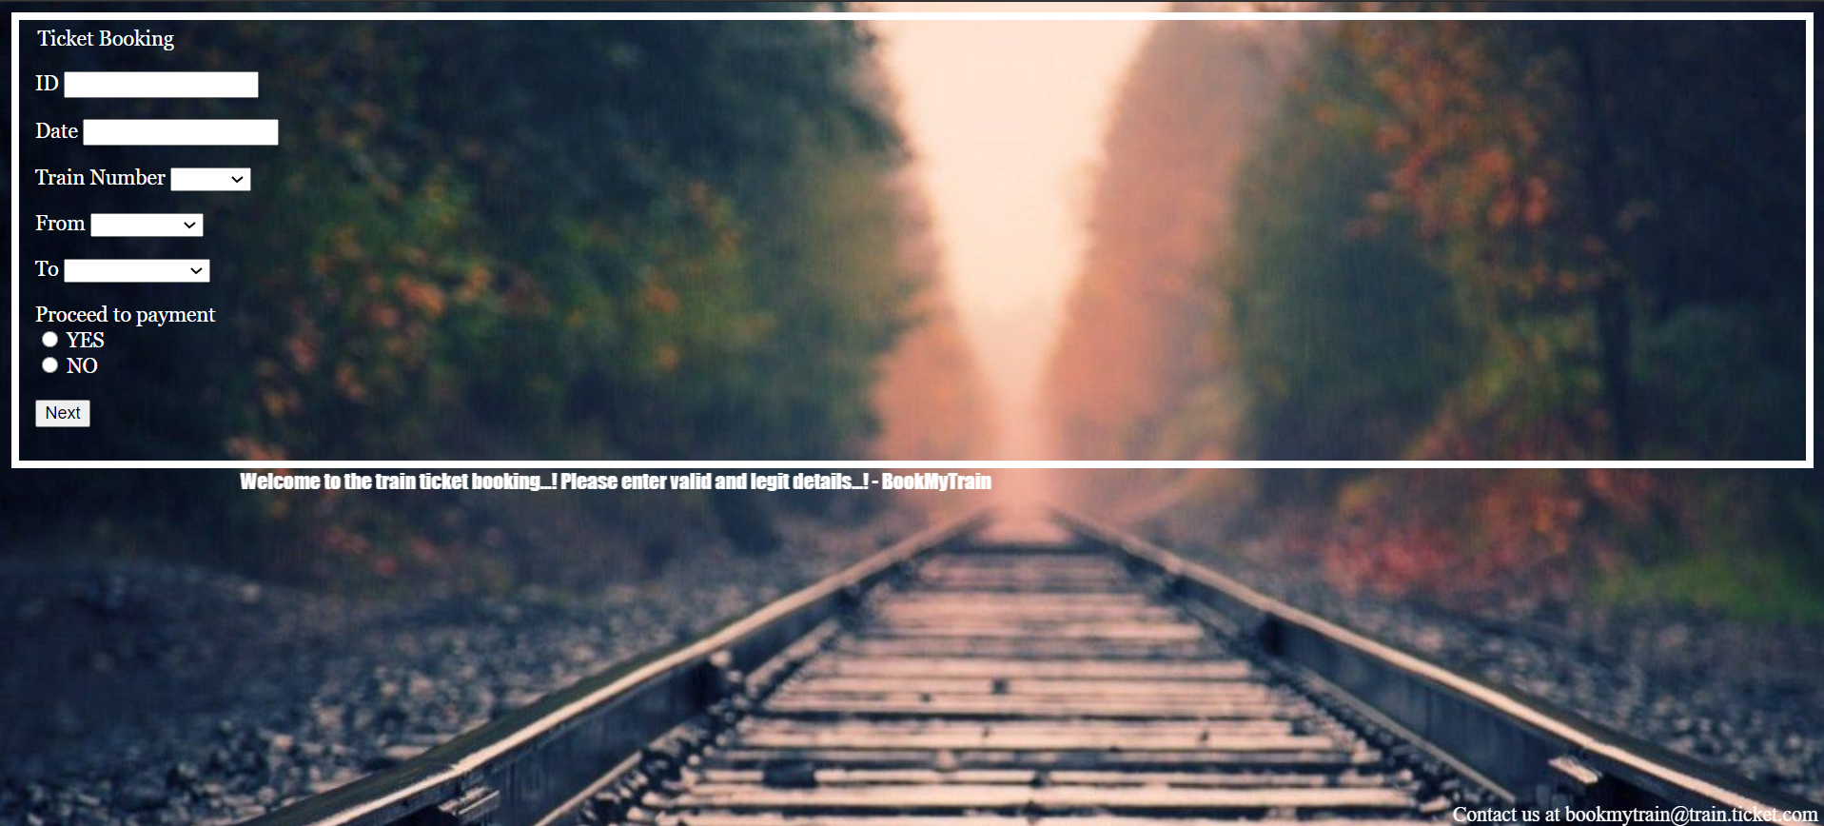
Existing

Slide 39
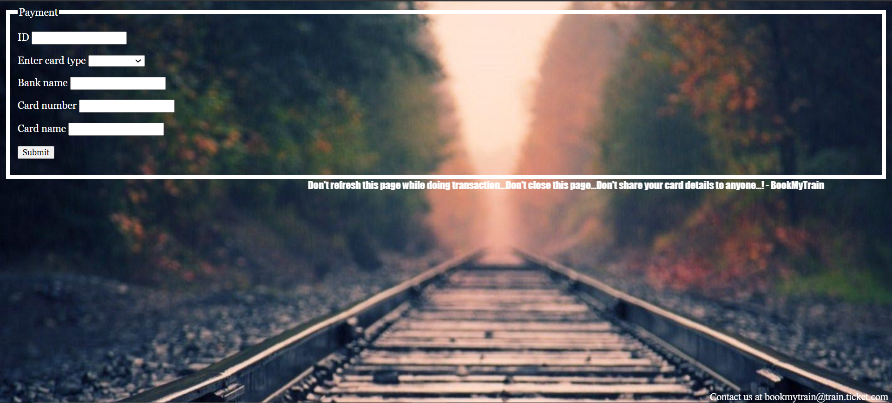
Payment

Slide 40
SUMMARY
TABLES-
train_table
ticket_price
running_status
passenger_details
travel_history
pay_details
card_details
TRANSACTION
ROLLBACK
INNER JOIN
NESTED IF
VIEWS

Slide 41
THANK YOU!

